Slide 1
Initium
A game by Jarod Haney, Luke Cunningham, Michael Franklin and Michael Siegert

Slide 2
The Basic Concept of the Game
Started with the idea that we wanted players to build the map, and then move into a combat phase
The basic premise of the game is for players to place and settle their own land as they build up to then conquer their opponents land

Slide 3
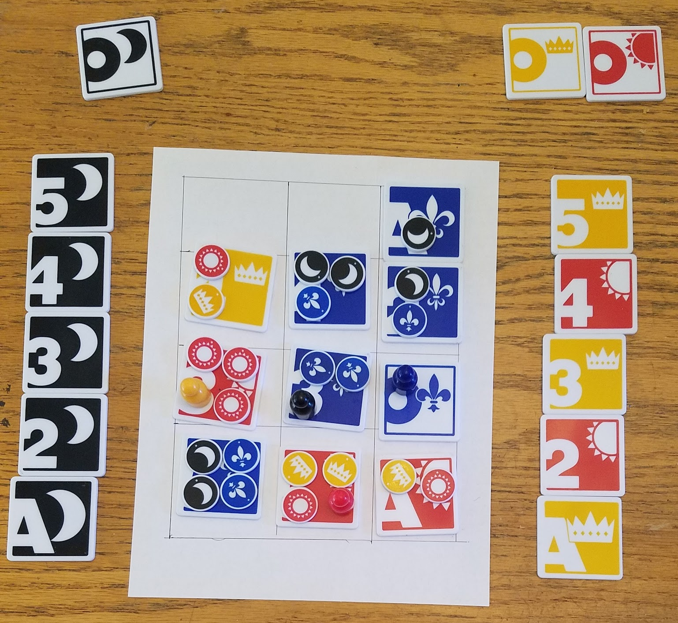
The First Iteration
Started off as the Michael’s PiecePack project
Most of the base game remained the same
The biggest problem with the original game was its confusing presentation
The rules of the game where relatively straightforward, but players often got confused until someone was able to explain the game to them in person

Slide 4
What We Changed
The first thing we wanted to do was to make the game playable for four players
The simplest way we could find to do this was to use two piece packs, and have each player play a seperate color
But as we began playtesting we found that the base game had some issues

Slide 5
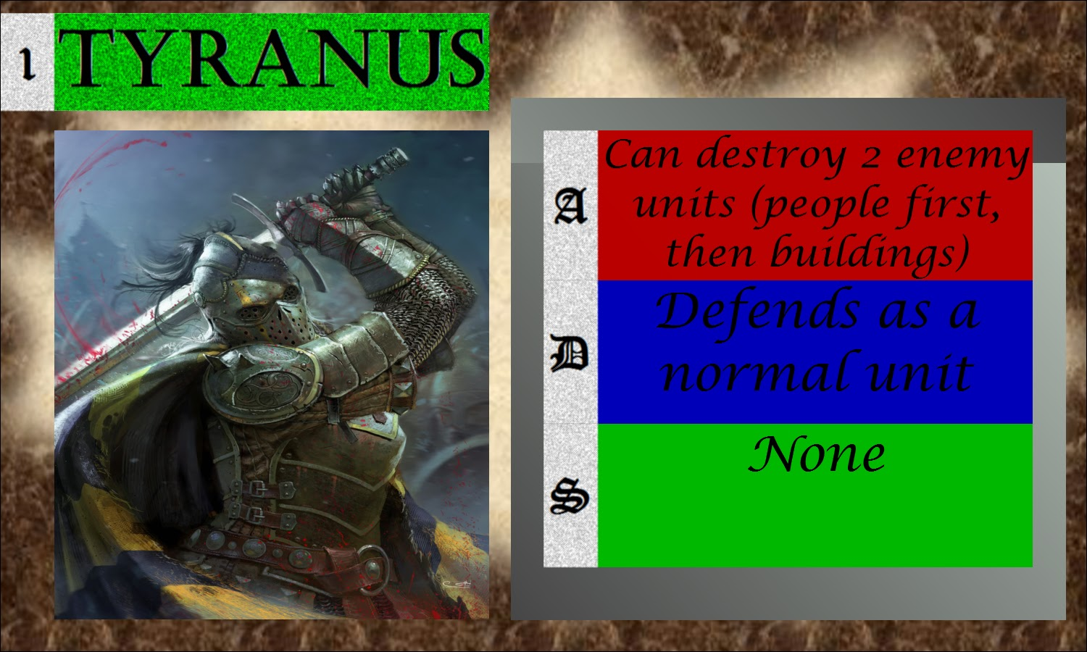
What We Changed
One of the first points of confusion in the base game was how one of the special units, the hero, would be defeated
In order to solve this and to expand the content of the game we added hero cards that explained the attributes of the hero

Slide 6
What We Changed
After our first playtest we realized that the game was very difficult to learn from the rulebook
In order to help resolve this issue we started trying to simplify mechanics
One thing we implemented was to have players choose between two wild tiles rather than three
We also made it so that our special building had to be placed on an existing building

Slide 7
What We Changed
One of the largest points of confusion in the base game was that both players played as two colors
By using two Piece packs, all 4 players had their own color, and we could include a three and four player variant
This made the game a little more intuitive

Slide 8
Gameplay Demo
https://drive.google.com/open?id=0B2Gspz4S0-7qWW1UaEdLRFVmTTQ

